Slide 1
CHAPTER 5.4.
MOBILITY AWARE SENSING DESIGN
S. Cacciapuoti, I. F. Akyildiz and L. Paura,
“Optimal Primary-User Mobility Aware Spectrum Sensing Design for Cognitive Radio Networks”,
IEEE Journal on Selected Areas in Communications, Nov. 2013.
1

Slide 2
Optimal Primary-User Mobility
Aware Sensing Design: Overview
  Spectrum sensing functionality by jointly
    maximizing the sensing efficiency
    satisfying the PU interference constraint
  in presence of Primary-User mobility.
2

Slide 3
Conventional Sensing Scenarios
Large-Scale PU Networks
    Static PUs
    CR users are always inside the PU range
      Their capability to sense the PU transmissions does not vary in time
3

Slide 4
Our Considered Sensing Scenarios
Small-Scale PU Networks
    Mobile PUs
    CR users can be out of the PU range
      Their capability to sense the PU transmissions varies in time
4

Slide 5
Why Small-Scale PU Networks?
  Gained a lot of attention recently
  Examples of small-scale PU networks:
    Ad hoc networks
    Wireless personal area networks
    HetNets (Small Cells)
    Wireless microphones
5

Slide 6
Why focus on Spectrum Sensing?
  Mobility changes dynamically the mutual distances among PUs and CR users
    CR capability to sense the PU transmission varies in time
    An effective sensing must be aware of the mobile PU dynamics
6

Slide 7

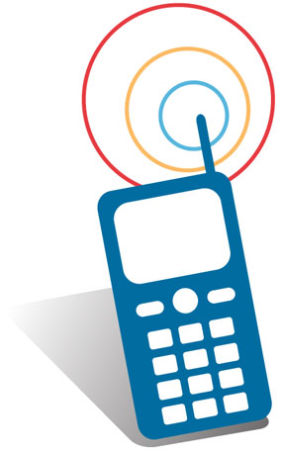
Example:
Impact of PU Mobility on Sensing
At time t the CR user is out
of the PU range
  it cannot sense the PU transmissions
After the PU movement, the
CR user is inside the PU range
  it can sense the PU transmissions
t
time
7

Slide 8
Objectives
IN MOBILE PU SCENARIOS:
Maximize the Sensing Efficiency
Satisfy the PU Interference Avoidance
8

Slide 9
How?
Tuning the sensing time and the transmission time
according to the mobile PU dynamics:
    How often must the sensing be performed in presence of PU mobility?
    How long must a spectrum band be sensed to reliably detect mobile PUs?
9

Slide 10
Why?
  Sensing time and transmission time influence both the spectrum
  efficiency and interference avoidance.
  Proper selection of these parameters is the most critical factor
  influencing the performance of CR networks.
10

Slide 11
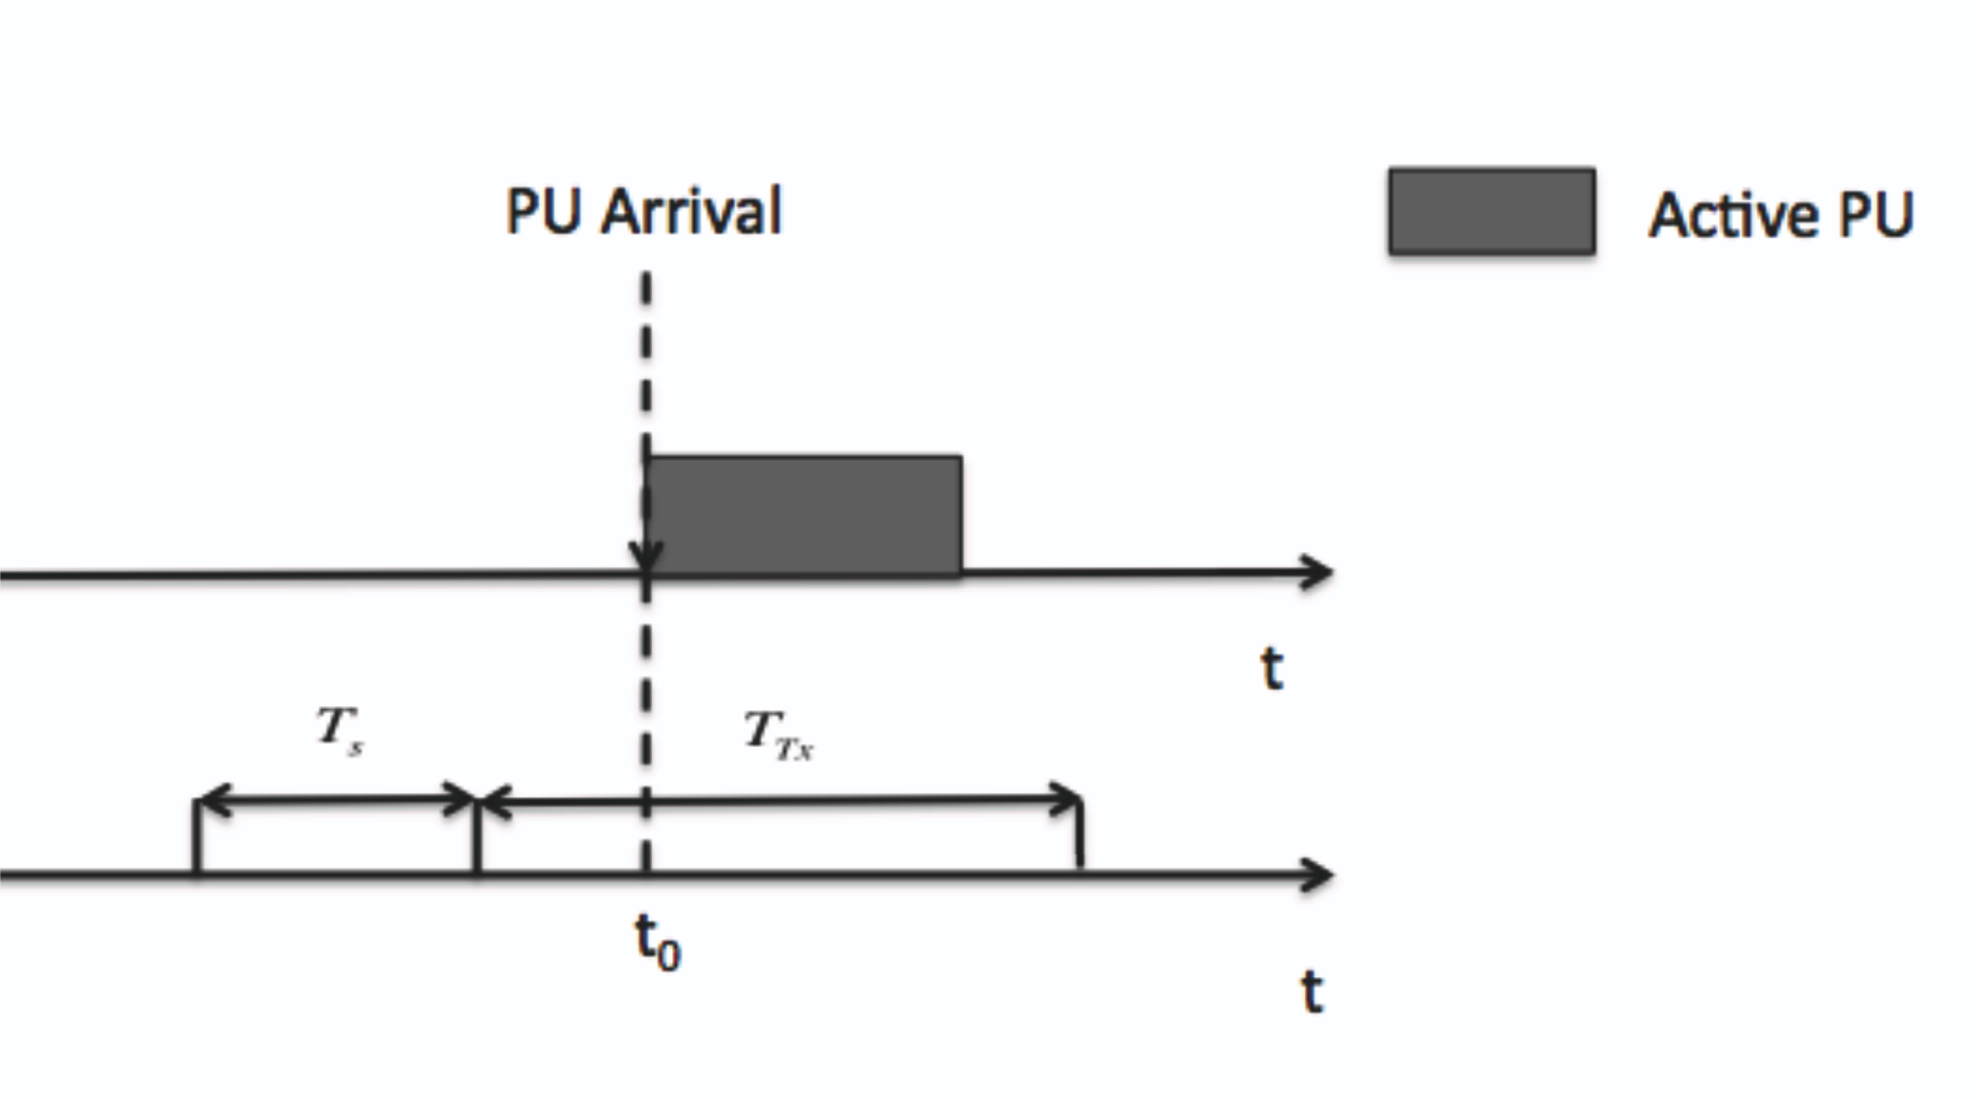
Example:
Transmission Time
Hypothesis: Ideal Sensing
  Static scenarios → no interference
  Mobile Scenarios → the interference can be greater than zero
    At the end of the sensing time T_{s}, CR user correctly decides to use the band
    At t₀,an active PU arrives during the CR transmission time
    CR user interferes with the PU, despite the perfect sensing decision
11
Notes:
At the end of the sensing time T_{s}, the CR user correctly decides to use the monitored spectrum band, since it does not detect any PU transmission during the sensing time. However, at time t_0 in T_{Tx} a mobile PU enters in the CR range. As a consequence, if the PU is active, the CR user interferes the PU, despite the perfect sensing decision.

Slide 12
Example:
Sensing Time
Static Scenarios:
  A CR user is always inside the PU range → Sensing is mandatory
Mobile Scenarios:
  A CR user can be out of the PU range
  If the prob of being inside the PU range is lower than the maximum interference prob tolerated by the PU
  → Sensing is useless
    Sensing time should be set equal to zero since the CR prob to interfere the PU is lower than the PU interference constraint.
12

Slide 13
CONTRIBUTIONS
1. Optimal transmission time for a general mobility model
Jointly maximize the sensing efficiency and satisfies the PU interference constraint.
2. Proof of a threshold behavior in the sensing accuracy as a function of the sensing time:
in mobile scenarios the sensing accuracy decreases for [sensing times > threshold value]
SURPRISE !!!!!
In static scenarios:
longer sensing times → higher sensing accuracy → less interference
13

Slide 14
CONTRIBUTIONS
3. Closed-form expression of the optimal sensing time threshold
for a general mobility model
4. Practical rules for setting the transmission time and the sensing time when
the PUs move according to Random Walk Mobility Model (RWM)
5. Evaluation of the sensing efficiency →
it can increase in presence of Mobile PUs
This is the first work in literature that addresses the above issues !!
14

Slide 15
Network Models
  PU Mobility Model (Assumption 1):
  * Memoryless mobility pattern constituted by a sequence of movement periods
  * During each period, a PU does not change its direction and its velocity
      Assumption 1 is assumed as general mobility model.
15
Notes:
15

Slide 16
Network Models
  PU Traffic Model:
  Two state birth-death process with death rate α and birth rate β
  ON (Busy) State: PU → active with probability P_{on}= β/(α+β)
  OFF (Idle) State: PU → inactive with probability P_{off}= α/(α+β)
* CR User Network Model
  CR users static, uniformly distributed in the network region A,
  assumed either as a line or as a square.
16
Notes:
16

Slide 17
Mobility-Aware Sensing Design: Overview
First Part of the paper:
  Characterization of the PU inter-arrival time for a general mobility model
Second Part of the paper:
  Derivation of the optimal sensing time parameters (sensing time and
  transmission time), by exploiting the results of the first part
Third Part of the paper:
  Specialization of the previously derived results for RWM.
Notes:
17

Slide 18
Mobility-Aware Sensing Design: Some Definitions
PU Protection Range R
  To avoid any interference on PUs,
  CR users detect active PUs within a range R, called PU Protection Range
  (determined by PU transmission range and by CR interference range)
Maximum Interference Prob P_{int}
  P_{int} → max. value of the interference prob. that a PU can tolerate
Event I: CR user is inside the PU protection range
Event O: CR user is out of the PU protection range
18

Slide 19
Mobility-Aware Sensing Design: Some Definitions
CR Interference Region:
  C(x_{CR}) is a disk of radius R (PU protection range) around the CR user location x_{CR.}
  Any CR user is inside the PU protection range R (Event I occurs),
  if the PU is placed within the CR interference region C(x_{CR}),
  i.e., if the Euclidean distance between the CR user and the PU is not greater than R.
  Event I occurs: Event O occurs:
R
PU
R
PU
x_{CR}
x_{CR}
C(x_{CR})
C(x_{CR})
19

Slide 20
Mobility-Aware Sensing Design: Some Definitions
MOVEMENT LENGTH L:
  RV L → Euclidean distance covered by a PU during a movement period
MOVEMENT DURATION D:
  RV D → time spent by a PU to complete a movement period
L=l_{i}
x_{PU}(t_{β})
x_{PU}(t_{α})
t_{α}
t_{β}
time
D=d_{i}=t_{β}-t_{α}
20
Notes:
In the figure, a realization of the random variable L , i.e., L=l_{i}, is shown along with a realization of the random variable D, i.e., D=d_{i}. Specifically, x_{PU}(t_{α}) and x_{PU}(t_{β}) denote the PU locations at the time instant t_{α} and t_{β}, respectively. Hence the time the PU spends to complete the movement is D=d_{ii}= t_{β} – t_{α}, and the Euclidean distance covered by the PU is L=l_{i}.

Slide 21

Mobility-Aware Sensing Design: Some Definitions
Out Time Θ:
  Time interval a PU (starting from its steady-state spatial distribution) spends out of the interference region of an arbitrary CR user:
||•|| denotes the Euclidean distance
∧ denotes the logical operator “and”.
PU Departure
PU Arrival
PU Arrival
Θ
t₁
t
Time
21
Notes:
Infimum (partially ordered sets) (greatest lower bound)
The out time is the difference between the first time (t) the PU re-enters in the CR interference region and the last time (t1) the PU was in the CR interference region, with t1<t
t⁻₁ denotes the left limit, i.e, lim_(epsilon -->0 ) (t1-epsilon), hence with the notation X_{PU}(t1^-) we denote the evaluation of the PU location X_{PU}(.) in a time instant that goes to t1 from the left side: X_{PU}(t1^-)=lim_(epsilon ->0) X_{PU}(t1-epsilon)
t1^+ denotes the right limit, i.e., lim_(epsilon -->0 ) (t1+epsilon), hence with the notation X_{PU} (t1^+) we denote the evaluation of the PU location X_{PU}(.) in a time instant that goes to t1 from the right side: X_{PU} (t1^+)=lim_(epsilon ->0) X_{PU}(t1+epsilon).
Hence, with the theta formula, we are saying that the out time is the time interval the PU spends out of the CR interference region such that at time t1^- the PU is still inside the CR interference region and at time t1^+ the PU is out

Slide 22
Mobility-Aware Sensing Design: Some Definitions
Out Time Θ: Time interval a PU spends out of the CR interference region
PU Arrival
PU Departure
PU Arrival
Θ
t₁
t
time
X_{PU}(t₁⁺)
C(x_{CR})
X_{PU}(t₁⁻)
R
R
X_{PU}(t)
R
X_{CR}
X_{CR}
X_{CR}
22
Notes:
- At time t1^- the PU is still inside the CR interference region C(X_{CR}) (the Euclidean distance between the PU location and the CR location is smaller than R),
At time t1^+ the PU is out of the CR interference region
Time t is the first (inf_{t >t₁ }) time instant in which the PU re-enters in the CR interference region (the Euclidean distance between the PU location and the CR location is smaller than R)

Slide 23



Out Time: Numerical Example
Out Time Θ:
  Assume:
    R=30m, t₁= 3 sec., t= 7 sec. Θ = (7-3) sec= 4 sec.
X_{PU}(t₁⁺)
C(x_{CR})
X_{PU}(t₁⁻)
R
R
X_{PU}(t)
R
X_{CR}
X_{CR}
X_{CR}
23
Notes:
- At time t1^-= 3⁻, the PU is still inside the CR interference region C(X_{CR}) (the Euclidean distance between the PU location and the CR location is smaller than R=30m),
At time t1^+ the PU is out of the CR interference region (the Euclidean distance between the PU location and the CR location is greater than R=30m),
Time t is the first (inf_{t >t₁ }) time instant in which the PU re-enters in the CR interference region (the Euclidean distance between the PU location and the CR location is smaller than R=30m)
With these values, the out time, i.e., the difference between the first time (t) the PU re-enters in the CR interference region and the last time (t1) the PU was in the CR interference region, with t1<t, is equal to 4sec.

Slide 24

Mobility-Aware Sensing Design: Some Definitions
Sojourn Time S:
  Time interval a PU (starting from its steady-state spatial distribution) spends inside a CR interference region:
||•|| denotes the Euclidean distance
∧ denotes the logical operator “and”.
PU Arrival
PU Departure
S
PU Arrival
t₀
t
Time
24
Notes:
Hence, with the S formula, we are saying that the sojourn time is the time interval the PU spends inside the CR interference region such that at time t0^- the PU is out of the CR interference region and at time t0^+ the PU is inside. To evaluate the sojourn time, we need to consider the greatest t (sup_(t >t₀) ) such that at time t the PU is still inside the CR interference region.

Slide 25
Mobility-Aware Sensing Design: Some Definitions
Sojourn Time S: Time interval a PU spends inside a CR interference region
PU Arrival
PU Departure
PU Arrival
S
t₀
t
Time
C(x_{CR})
X_{PU}(t₀⁻)
X_{PU}(t₀⁺)
X_{PU}(t₀⁺)
R
R
X_{PU}(t)
R
X_{CR}
X_{CR}
X_{CR}
25
Notes:
- At time t₀^- the PU is out of the CR interference region C(X_{CR}) (the Euclidean distance between the PU location and the CR location is greater than R),
At time t₀^+ the PU is inside the CR interference region
Time t is the last (sup_{t >t₀ }) time instant in which the PU is inside the CR interference region (the Euclidean distance between the PU location and the CR location is smaller than R)

Slide 26



Sojourn Time: Numerical Example
Sojourn Time S:
  Assume:
    R=30m, t₀= 10sec, t= 11sec S = (11-10) sec = 1sec.
X_{PU}(t₀⁻)
X_{PU}(t₀⁺)
X_{PU}(t₀⁺)
R
R
X_{PU}(t)
R
C(x_{CR})
X_{CR}
X_{CR}
X_{CR}
26
Notes:
- At time t₀^-=10⁻ sec the PU is out of the CR interference region C(X_{CR}) (the Euclidean distance between the PU location and the CR location is greater than R=30),
At time t₀^+= 10⁺ the PU is inside the CR interference region
Time t=11 is the last (sup_{t >t₀ }) time instant in which the PU is inside the CR interference region (the Euclidean distance between the PU location and the CR location is smaller than R=30m)
With these values, the sojourn time, i.e., the difference between the last time (t) the PU is in the CR interference region and the first time (t0) the PU was in the CR interference region, with t0<t, is equal to 1sec.

Slide 27
Mobility-Aware Sensing Design: Some Definitions
Inter-Arrival Time T:
  Time interval between two consecutive arrivals of the PU in the interference region of a CR user.
  Inter-arrival time T is equal to the sum of the sojourn time and of the out time:
PU Arrival
PU Arrival
T
S
Θ
t₀
t
Time
27

Slide 28
Inter-Arrival Time: Numerical Example
Inter-Arrival Time T:
  From examples on Slides 23 and 26:
  S = 1sec and Θ = 4sec T =(1+4)sec = 5sec
PU Arrival
PU Arrival
T=5sec
S=1sec
Θ=4sec
t₀
t
Time
28

Slide 29
Mobility-Aware Sensing Design: Overview
First Part of the paper:
-Characterization of the PU inter-arrival time for a general mobility model
Second Part of the paper:
  Derivation of the optimal sensing time parameters (sensing time and
  transmission time), by exploiting the results of the first part
Third Part of the paper:
  Specialization of the previously derived results for the RWM
Notes:
29

Slide 30


Primary-User Inter-Arrival Process:
Average Value of the Inter-Arrival Time
  Theorem 1: Average inter-arrival time of a PU roaming within a network region A according to a general mobility model is:
with:
  * P(I) is the prob of event I.; i.e., % of time that a CR user is located within PU protection range R
* the average out time is equal to
* pdf of the CR user spatial distribution
* pdf of the PU steady-state spatial distribution, i.e., the PU spatial distribution after the
transition
* f_{L}(l) pdf of the RV L (Defined in slide 20)
* average value of the RV D (Defined in slide 20)
30
Notes:
Through slides 30-32, we describe the First Part of the paper, i.e., we characterize the PU inter-arrival time T (defined in slide 27) for a general mobility model, by deriving closed-form expressions for both its average value E[T](Theorem 1, slide 30) and its Cumulative Distribution Function (CDF) (Theorem 2, slide 33). These results will be used to set the optimal mobility-aware sensing time parameters, i.e., the sensing time and the transmission time (second part of the paper, slide 35-51).
A general mobility model is any mobility model satisfying Assumption 1 (slide 15). RWM and RWMP are examples of mobility models satisfying Assumption 1 (slide 15). In the third part of the paper we specialize the results derived with reference to a general mobility model for the RWM and the RWPM.

Slide 31
Primary-User Inter-Arrival Process
Average value of the Inter-Arrival Time
  holds for every mobility model satisfying Assumption 1 (Slide 15).
  Depends on three factors:
    PU mobility model, through the PU steady-state spatial distribution
    f_{L}(l), and
    CR spatial distribution
    Prob P(I) of an arbitrary CR user being inside the PU protection range.
31

Slide 32


Average Value of the Inter-Arrival Time: Numerical Example
  Theorem 1:
    Assume: P(I) = 0.03 and
With this setting, the average time between two consecutive arrivals of a PU inside the CR interference
region is roughly 10.3 sec. This means a CR user waits in average 10.3 sec before to meet again the PU.
32
Notes:
When we will specialize the results for the RWM and the RWPM (third part of this presentation), we will understand how the mobile PU parameters, e.g., the average PU velocity, the PU protection range etc., affect the calculation of these quantities (Theta, T etc.)(see examples reported in the third part of this presentation)

Slide 33


Primary-User Inter-Arrival Process:
Cumulative Distribution Function (CDF) of the Inter-Arrival Time
  Theorem 2: CDF of the inter-arrival time of a PU roaming within a network region A according to a general mobility model is bounded by:
where is the average value of the RV D and Pg(xCR) is the prob that a mobile PU meets the CR user (with location x_{CR}) during a PU movement and given by:
33
Notes:
Theorem 2 is saying that the probability that the inter-arrival time assumes values smaller than t, i.e., its CDF, is bounded by an exponential low dominated by the parameter P_{g}(x_{CR}).
P_{g}(x_{CR}) represents the probability that a mobile PU meets the CR user (whose location is x_{CR}) during a PU movement.
It is composed by two integral since:
the first integral (int_C(X_{CR}, l )) represents the probability that a mobile PU meets the CR user (whose location is X_{CR}) during a PU movement of length L=l_{i} (the r.v. L is defined in slide 20)
the second integral (int_L) is necessary to remove the conditioning with respect to L=l_{i}.

Slide 34


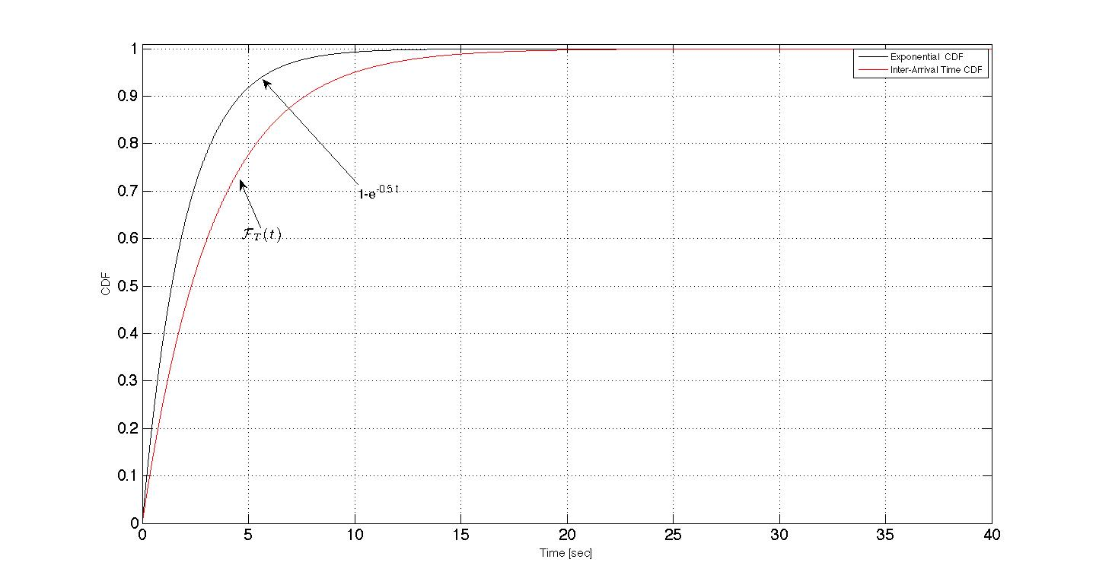

CDF of the Inter-Arrival Time: Numerical Example
  Theorem 2:
Consider a squared network region A=[0,a]x[0,a] and assume P_{g}(x_{CR}) independent from the CR user location with
since , it results:
34

Slide 35
Mobility-Aware Sensing Design: Overview
First Part of the paper:
  Characterization of the PU inter-arrival time for a general mobility model
Second Part of the paper:
  Derivation of the optimal sensing time parameters (sensing time and
  transmission time), by exploiting the results of the first part
Third Part of the paper:
  Specialization of the previously derived results for the RWM
Notes:
35

Slide 36
Optimal Mobility Aware Sensing Parameters
Find Optimal Mobility Aware Sensing Parameters
(Sensing Time T_{s} and Transmission Time T_{TX})
STEPS:
  Optimal Mobility-Aware Transmission Time
  Optimal Mobility-Aware Sensing Time Threshold
  Mobility-Aware Sensing Time
36
Notes:
36
Here by exploring the characterization of the inter-arrival time (derived in the previous slides), we address the proper selection of the sensing parameters. This is crucial for the performance of CR networks since the sensing time and the transmission time influence both the spectrum efficiency and interference avoidance.

Slide 37

Optimal Mobility-Aware Transmission Time
Definition: is the transmission time that:
  * allows a CR user to respect the PU interference constraint
  * maximizes the sensing efficiency for a given value of the sensing time.
37
Notes:
37

Slide 38


Optimal Mobility-Aware Transmission Time
Theorem 3: Consider a PU roaming in a network region A according to a general mobility model, then
  where:
  CDF of the PU inter-arrival time (Theorem 2)
  * P_{int} maximum interference probability
  P_{on} PU on-state probability
38
Notes:
38
A general mobility model is any mobility model satisfying Assumption 1 (slide 15).

Slide 39
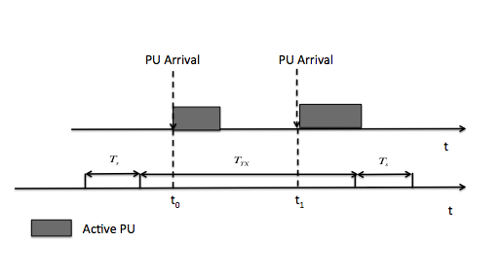

Explanation
During two PU arrival events, a CR can interfere an active PU during T_{Tx}
  T_{Tx} cannot exceed the maximum interference time an active PU can tolerate between two arrival events, i.e.:
Optimal transmission time is the
maximum T_{Tx} satisfying this equation
  .
39
Notes:
When the inter-arrival time (temporal distance between two consecutive arrivals of the PU in the CR interference region) is lower then the transmission time, then the CR user can interferes with the active PU, since the PU arrives during the transmission time.
Hence, we want that the probability of a PU I) being active (P_on) and ii) arriving during the CU transmission time ( P(T<= T_Tx) is lower then the PU interference constraint (P_int).

Slide 40
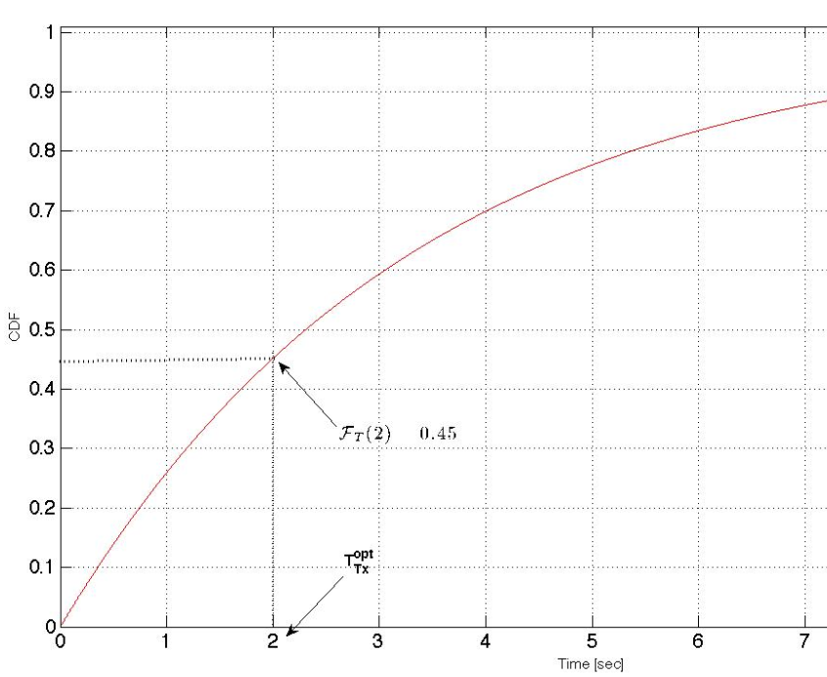

Optimal Mobility-Aware Transmission Time:
Numerical Example
Theorem 3:
Given: P_{int}/P_{on}= 0.45 and reported in Figure
A CR User can transmits for 2 sec,
by satisfying the PU interference
constraint
40
Notes:
40

Slide 41

Optimal Mobility-Aware Sensing Time Threshold
Definition: Optimal sensing time threshold is the maximum value of the sensing time assuring that:
    the sensing accuracy does not increase by observing the band for times
    longer than , regardless of the adopted sensing technique.
Sensing Accuracy
Ψ_{s}^{opt}
Sensing Time
41
Notes:
41

Slide 42

Optimal Mobility-Aware Sensing Time Threshold
Theorem 4: The optimal sensing time threshold is equal to the average sojourn time of a mobile PU inside the CR interference region:
  where:
  and given in Theorem 1
  P(I): prob. of a CR user being inside the PU protection range,
  i.e., % of time that a CR user is located within R.
42
Notes:
42
Theorem 4 is saying that observing the band for a time longer than the average sojourn time does not increase the sensing accuracy.
This agrees with the intuition: if the event O occurs, i.e., if the PU is not in the CR interference region, the CR user can use the band without interfering the PU, hence it is useless to waste time by sensing a free band.
Slides 45-47 provides a formal proof for Theorem 4.

Slide 43
Optimal Mobility-Aware Sensing Time Threshold:
Graphical Representation
Theorem 4: is equal to the average sojourn time
PU Departure
Sensing Accuracy
PU Arrival
PU Arrival
S
=
Sensing time
t₀
t
time
43
Notes:
43

Slide 44


Optimal Mobility-Aware Sensing Time Threshold:
Numerical Example
Theorem 4:
Utilize the same values of the prev. example:
P(I)=0.03,
The maximum value of the sensing time, i.e. the sensing time threshold, , is equal to 0.31 sec.
44
Notes:
44

Slide 45


Explanation
H_{o}: no PU signal, H₁: PU signal
Hypothesis Test for CR users under Event I:
  CR user can sense the PU transmissions
Hypothesis Test for CR users under Event O:
CR user cannot sense the PU transmissions
CR
R
R
PU
PU
CR
45
Notes:
45

Slide 46

Explanation
Hence the Detection and the False Alarm Probabilities:
    Y and γ denote the decision variables and the threshold of the generic adopted sensing technique, respectively.
If the event O occurs, the CR user cannot sense the PU
46
Notes:
46

Slide 47

Explanation
Consequently
  P_{d} affected only by the event I
  P_{f} affected by both the events I and O with
From P_{d} and P_{f} it follows that observing the spectrum for a time greater
than the average sojourn time S has two effects:
  P_{d} does not improve
  P_{f} can increase
agrees with the intuition: if the event O occurs, the CR user can use the spectrum without interfering the PU
  it is useless to waste time by sensing a free spectrum.
According to the definition of ,
47
Notes:
47

Slide 48

Mobility-Aware Sensing Time
Corollary 1: Consider a PU roaming within a network region A according to a general mobility model.
The mobility-aware sensing time T_{s} must be set:
    Direct consequence of Theorem 4
48
Notes:
48
Corollary 1 is saying that the sensing time cannot exceed the average sojourn time, since we have proved (Theorem 4, slide 42) that observing the band for a time longer than the average sojourn time can decrease the sensing accuracy

Slide 49

Mobility-Aware Sensing Time:
Numerical Example
Corollary 1:
From the example:
A CR user senses the spectrum for a time not longer than 0.31 sec.
49
Notes:
49

Slide 50

Mobility-Aware Sensing Time
Insight: The amount ν(P_{d};P_{f}) of the average sojourn time used for sensing depends on:
  required detection accuracy (P_{d}; P_{f}) &
  adopted sensing technique.
  Hence
  ν(P_{d};P_{f}) accounts for the targeted detection accuracy and the adopted sensing technique characteristics.
50
Notes:
50
This provides a practical rule for setting Ts according to the mobile PU dynamics
T^ is the average inter-arrival time of a PU roaming within a network region A derive din Theorem 1 (slide 30)
P(I) denotes the percentage of time that the CR user is located within the PU region

Slide 51
Mobility-Aware Sensing Time
Insight:
  If then T_{s} 0
    if the CR is never in the PU protection range, it is useless to sense the spectrum
  If i.e., if CR is always in the PU protection range,
  T_{s} must be set according to the static scenario rules or
  duality if the PU is always in the CR interference region
51
Notes:
51

Slide 52
Mobility-Aware Sensing Design: Overview
First Part of the paper:
  Characterization of the PU inter-arrival time for a general mobility model
Second Part of the paper:
  Derivation of the optimal sensing time parameters (sensing time and
  transmission time), by exploiting the results of the first part
Third Part of the paper:
  Specialization of the previously derived results for RWM
Notes:
52
RWM and RWMP are examples of mobility models satisfying Assumption 1 (slide 15). In the third part of the paper we specialize the derived results for the RWM and the RWPM.

Slide 53
Random Walk Mobility Model (RWM)
A PU chooses uniformly at random both a direction and a velocity in the intervals [0; 2π] and [v_{min}; v_{max}] m/s
Each movement occurs in a constant time
When the edge of the network region A is reached, the PU is bounced back to the region A.
Uniform steady-state spatial distribution regardless of the average PU speed
53

Slide 54
Random Walk Mobility Model (RWM):
Graphical Representation
Network Region A
At time t_{α} , the PU in position x_{PU}(t_{α})
randomly selects a direction ω₁ and a
velocity v₁
Then PU moves for a constant time T,
reaching the position x_{PU}(t_{β}) at time t_{β}
Here, PU selects a new direction ω₂ and
speed v₂ according to the same rule
Since during this movement, PU reaches
the edge of A & is bounced back to
the region until reaching the position
x_{PU}(t_{γ}) at time t_{γ}
x_{PU}(t_{β})
ω₂
v₂T
v₁T
x_{PU}(t_{α})
ω₁
x_{PU}(t_{γ})
54

Slide 55
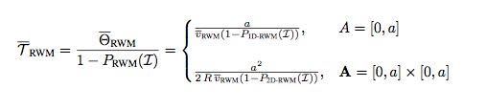
Primary-User Inter-Arrival Process for RWM
Theorem 1 for RWM: The average inter-arrival time of a PU roaming within a network region A according to the RWM is:
One-dimensional Network region
Bi-dimensional Network region
Θ is the average out time (average time interval a PU spends out of interference region of a CR user)
v_{RWM} is the average PU velocity
P_{RWM}(I) is the prob of event I (% of time a CR user is located within R)
for one-dimensional and bi-dimensional network regions, respectively
55
Notes:
This slide provides the specialization of Theorem 1 in slide 30 for the RWM
The expressions of P_{1D-RWM} (I) and P_{2D-RWM} (I) are not reported since are complicate but these expression depend only on the normalized protection radius R/a. A reader interested in their expressions can find them in the paper

Slide 56

Primary-User Inter-Arrival Process for RWM
depends on three factors:
  Average PU velocity
  Normalized protection radius R/a
  Size of the network region A
56

Slide 57



Average Value of the RWM Inter-Arrival Time:
Numerical Example
Theorem 1 for RWM:
Assume:
A squared network region A=[0,a]x[0,a]
R/a=0.01
i.e, CR user waits on the average roughly 250 sec
before to meet again a PU that is moving according to the RWM.
57

Slide 58


Primary-User Inter-Arrival Process for RWM
Theorem 2 for RWM:
The CDF of the inter-arrival time of a PU roaming within a network region A according to the RWM is bounded by an exponential distribution:
One-dimensional Network region
Bi-dimensional Network region
58
Notes:
This slide provides the specialization of Theorem 2 in slide 33 for the RWM.
Here we are saying that the probability that the inter-arrival time assumes values smaller than t, i.e., its CDF, is bounded by an exponential distribution of parameter Ω_{RWM}

Slide 59
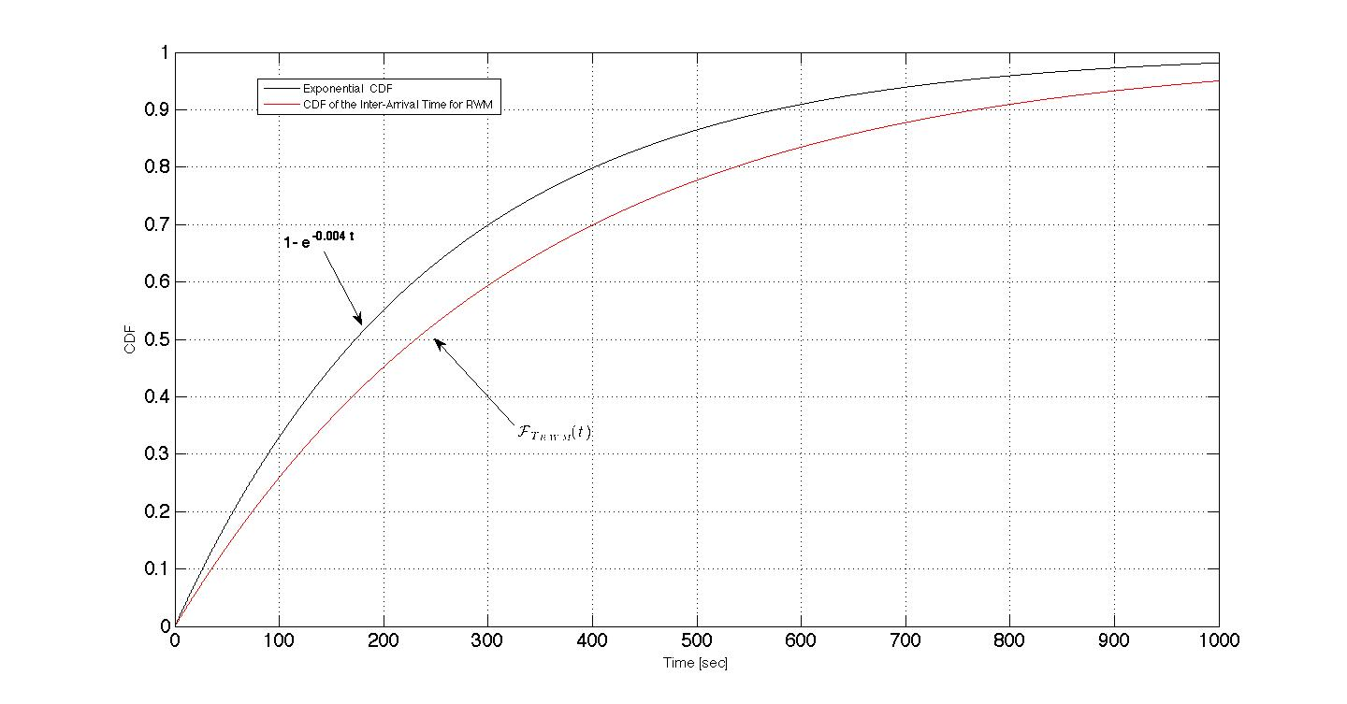


CDF of the Inter-Arrival Time for the RWM:
Numerical Example
Theorem 2 for RWM:
Assume:
A squared network region A=[0,a]x[0,a]
R/a=0.01
59

Slide 60




Optimal Mobility-Aware Transmission Time for RWM
According to Theorem 3, the optimal mobility-aware transmission time for RWM is:
where is given by Theorem 2 for RWM:
By combining these two results, the following bound is derived:
where θ is the average out time for the RWM.
According to this result, a CR user can transmit for a longer time than the product between the average out-time and
60
Notes:
Theorem 3 in slide 38 provides the rule for setting the optimal mobility-aware transmission time.
Here we are saying that by exploiting the bound derived for the RWM CDF we are able to set the optimal mobility-aware transmission time for this mobility model

Slide 61

Optimal Mobility-Aware Transmission Time for RWM
  The lower bound provides a practical rule for setting T_{TX} in mobile
  scenarios, in fact
    T_{TX} shorter than the derived bound causes sensing inefficiency
    T_{TX} longer than the derived bound can violate the PU interference constraint.
61

Slide 62



Optimal Mobility-Aware Transmission Time for RWM:
Numerical Example
Assume:
  A=[0,a]x[0,a]
  R/a=0.005
  P_{int}=10⁻²
  P_{on} = 0.2
A CR user can transmit for 10.26 sec
62
Notes:
Here we considered a different simulation setting (e.g. R/a=0.005 instead of 0.01) to show to the students how the different mobile parameters affect the sensing time parameters

Slide 63


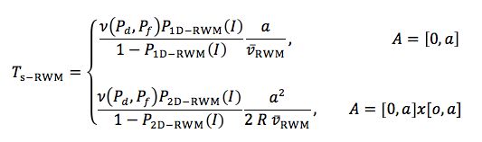
Mobility-Aware Sensing Time for RWM
According to Corollary 1 & the related insight, the mobility-aware sensing time for the RWM is
  where is given by Theorem 1 for RWM:
By combining these two results, the mobility-aware sensing time for the RWM is given by:
One-dimensional Network region
Bi-dimensional Network region
63
Notes:
63
Corollary 1 in slide 48 provides the rule for setting the optimal mobility-aware sensing time.
Here we are saying that by exploiting the average sojourn time derived for the RWM we are able to set the optimal mobility-aware sensing time for this mobility model
P_{1D-RWM} (I) and P_{2D-RWM} (I) (slide 55):
the probabilities of the event I (CR inside PU protection range) for one-dimensional and bi-dimensional network region
their expressions depend only on the normalized protection radius R/a
Their expressions are not reported since are complicate but a reader interested in their expressions can find them in the paper

Slide 64


Mobility-Aware Sensing Time for RWM:
Numerical Example
Continue the Example:
A=[0,a]x[0,a]
R/a=0.005
ν(P_{d}, P_{f}) =1
Since PU is very fast and at the same time has a small protection
range compared to the network region A, a CR user must sense the
channel for just 0.016 sec.
It can transmit for 10.26 sec.
High sensing efficiency by respectingat the same time the PU interference constraint
64
Notes:
64

Slide 65
Mobility-Aware Sensing Time for RWM:
Some Considerations
T_{s} depends on:
  normalized PU protection range R/a
  extension of the network area A
  average PU velocity
  sensing accuracy ν(P_{d}, P_{f})
65
Notes:
65

Slide 66

Mobility-Aware Sensing Efficiency
Definition: The mobility-aware sensing efficiency is the ratio of the optimal transmission time over the entire sensing period
By using the derived results, a lower bound of the sensing efficiency is evaluated.
66
Notes:
66
In slides 12-13 (Contributions) we have underlined that the sensing accuracy can increase in presence of Mobile PUs.
In this slide we show this statement.

Slide 67


Mobility-Aware Sensing Efficiency
η_{mob} depends on 3 factors:
  PU Interference Constraint P_{int}
  PU Mobility Model
  PU Traffic
η_{mob} reflects the dynamic nature of
  PU topology through P(I)
  PU traffic through P_{on}.
Given T_{s}, P_{int} and P_{on}, η_{mob} increases when
increases
  CR user spends more time out of the PU range and thus it can use the spectrum for a longer time with the same P_{int}
Given T_{s}, P_{int} and if
  CR user can transmit in an arbitrarily long time interval
67
Notes:
67
To derive this formula, we have substituted in the definition of the sensing efficiency the derived bound for the optimal transmission time

Slide 68
Results: Optimal Mobility-Aware Transmission Time
    T_{Tx} is set according to the lower bounds, P_{int}= 10⁻², v_{min}/a=0.1, v_{max}/a= 0.9
Theoretical results match well the simulation results
When R/a increases, T_{Tx} decreases
    CR spends more time in the PU range
When P_{on} increases, T_{Tx} decreases
    PU traffic dynamics increase

Slide 69
Results: Optimal Mobility-Aware Transmission Time
    Instantaneous Interference Level on the PU transmissions,
    P_{int}= 10⁻² (represented in the figures with the red lines), P_{on}= 1/3
The results confirm the benefits of setting T_{Tx} according to our results:
    the average interference levels on the PU for
    RWM are 9•10⁻³ < P_{int} and 6•10⁻³ < P_{int}

Slide 70
Results: Optimal Mobility-aware Sensing Time Threshold
The results validate the analysis:
  for T_{s} longer than the average sojourn time S, P_{f} increases
  Threshold behavior in the sensing accuracy
    False-alarm probabilities versus T_{s},
    SNR= -5 dB, Energy Detector, P_{d}=0.999

Slide 71
Results: Mobility-Aware Sensing Time
    T_{s} is set according to the analytical results for ν(P_{d},P_{f})=1
theoretical results match well the simulation results
when R/a increases, T_{s} increases
    CR probability of being inside the PU range increases
when v/a increases, T_{s} decreases
    CR spends more time out of the PU range

Slide 72
Conclusions
Mobile PU dynamics force researchers to revise the current
design of the sensing functionality for jointly
  maximizing the sensing efficiency
  satisfying the PU interference constraint
Sensing Time and Transmission Time Optimization
  Two fundamental questions are answered:
    How often must the sensing be performed in presence of PU mobility?
    How long must a spectrum band be sensed to reliably detect mobile PUs?
  A threshold behavior in the sensing accuracy as a function of the sensing time
72

Slide 73
Conclusions
The developed optimal mobility-aware sensing design
exhibits a very attractive feature:
  It does not depend on the instantaneous values of the PU mobility
  pattern but only on the average statistics such as average PU
  sojourn time and the average PU out time
73

