Slide 2
CHAPTER 1.
INTRODUCTION

Slide 3
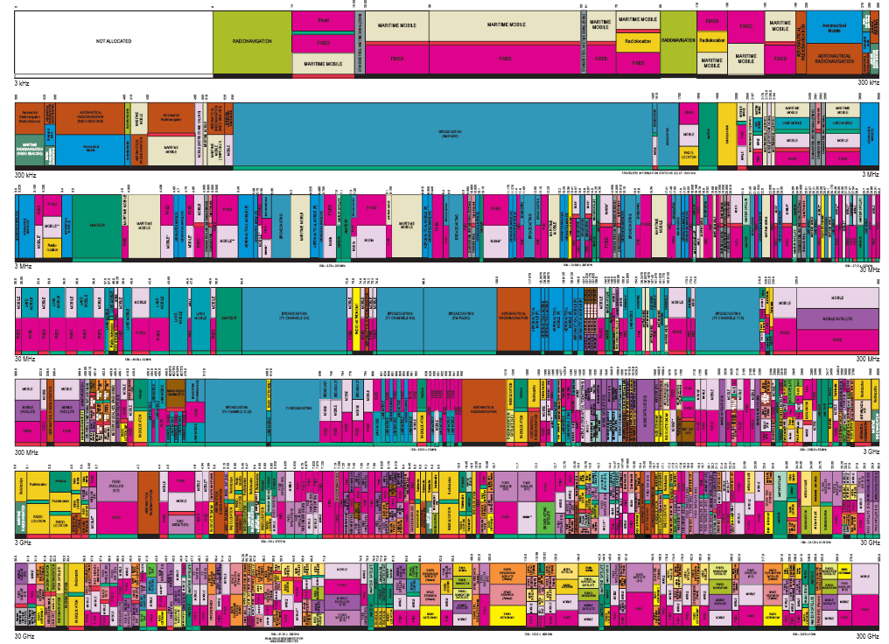
FIXED SPECTRUM ASSIGNMENT

Slide 4
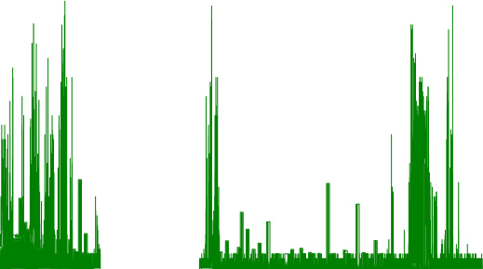
Fixed Spectrum Utilization
Maximum Amplitudes
Heavy Use
Heavy Use
Amplitude (dBm)
Sparse Use
Medium Use
Frequency (MHz)

Slide 5
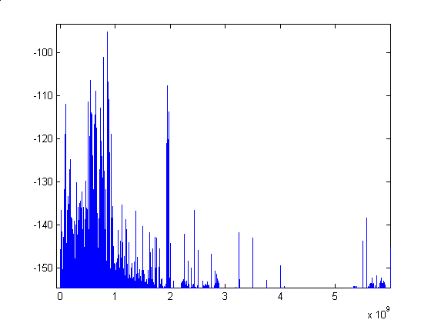
Fixed Spectrum Utilization
PSD (Power Spectrum Density)
GHz
Freq (GHz) | 0~1 | 1~2 | 2~3
Utilization(%) | 54.4 | 35.1 | 7.6
3~4 | 4~5 | 5~6
0.25 | 0.128 | 4.6
Measurements show that there is wide range of spectrum utilizations
across 6 GHz of spectrum

Slide 6
Problems of Fixed Spectrum Utilization
Spectrum usage is concentrated on certain portions of the spectrum
A significant amount of the spectrum remains unutilized.
According to FCC (Federal Communication Commission):
Utilization of the fixed spectrum assignment is approx.
15-85% based on temporal and geographical variations
→ Limited Available Spectrum and Inefficient Spectrum Usage!

Slide 7
COGNITIVE RADIO NETWORKS;
DYNAMIC SPECTRUM ALLOCATION NETWORKS (DSANs); xG INITIATIVE
Dynamic Spectrum
Allocation

Slide 8
OVERALL VIEW
Applications
Adaptive
Protocol
Suite
TCP/UDP
IP
MAC
Error Control
Physical
Dynamic Spectrum
Allocation
WiMAX
Wireless
LANs & MANs
Cellular
(2,3,4-G)
Sensor
Networks
Mesh Networks

Slide 9
COGNITIVE RADIO
A “Cognitive Radio” is the key enabling technology for Dynamic Spectrum Access!!
Capability to use or share the spectrum in an opportunistic manner.
“BANDWIDTH HARVESTING”
Dynamic spectrum access techniques allow the CR to operate in the
best available channel.

Slide 10
SPECTRUM MANAGEMENT FRAMEWORK
1) Determine which portions of the spectrum is available and detect the
presence of licensed users when a user operates in a licensed band
(Spectrum Sensing)
2) Select the best available channel (Spectrum Decision)
3) Coordinate access to this channel with other users (Spectrum Sharing)
4) Vacate the channel when a licensed user is detected
(Spectrum Mobility).

Slide 11
COGNITIVE RADIO NETWORK
COMMUNICATION FUNCTIONALITIES
Application Control
QoS Requirements
Spectrum
Mobility
Function
Application
Spectrum
Decision
Function
Handoff Delay, Loss
Transport
Reconfiguration
Routing Information
Routing Information/
Reconfiguration
Network Layer
Scheduling
Information/
Reconfiguration
Link Layer
Delay
Spectrum
Sharing
Link Layer
Spectrum
Sensing
Physical Layer
Sensing
Information
Sensing Information / Reconfiguration
Handoff Decision, Current and Candidate Spectrum Information

